Slide 1

Machine Learning for Single Cell Analysis
Course introduction
Notes:
TA introduction
Talk about not teaching code (not a programming workshop)

Slide 2
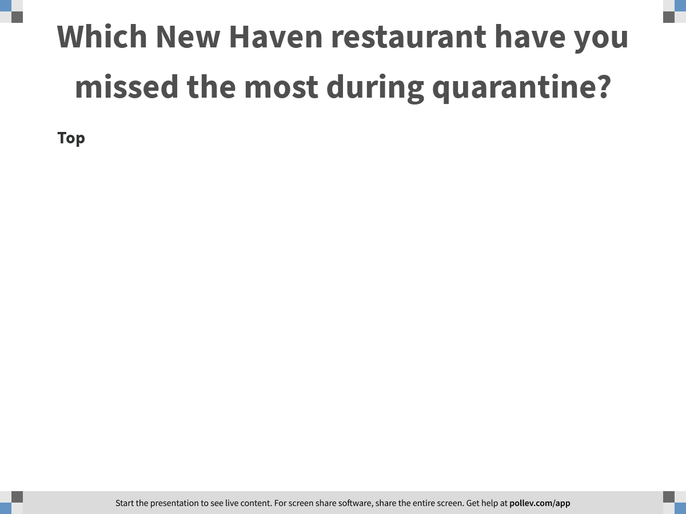
Notes:
Which New Haven restaurant have you missed the most during quarantine?
https://www.polleverywhere.com/discourses/GZw6WQTgo90DLwObX6vsK

Slide 3


Slide 4
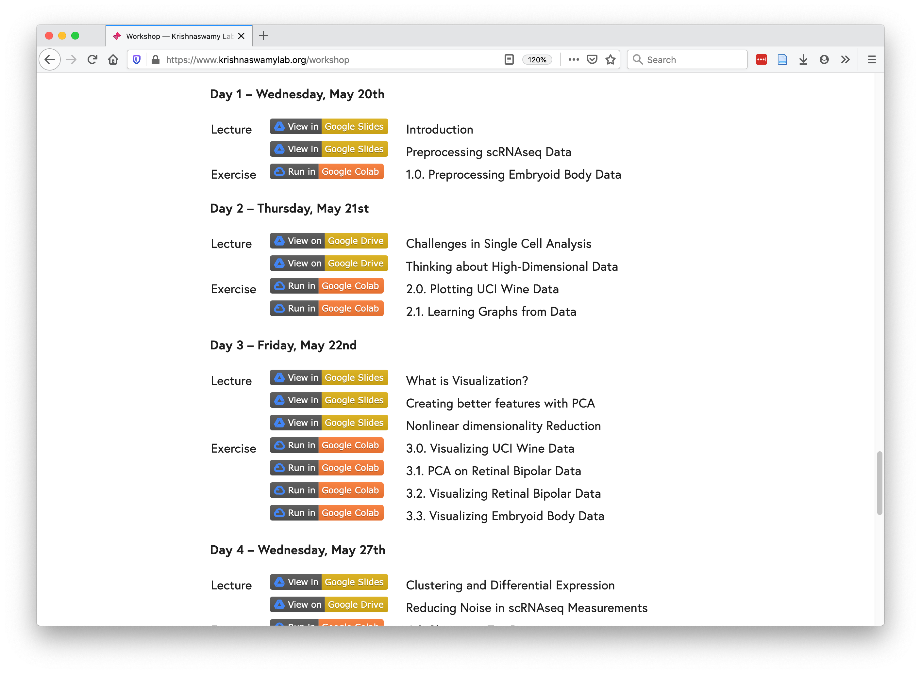
Course structure
https://www.krishnaswamylab.org/workshop

Slide 5

Team programming
https://bit.ly/May2020GroupAssignments
Noun project

Slide 6
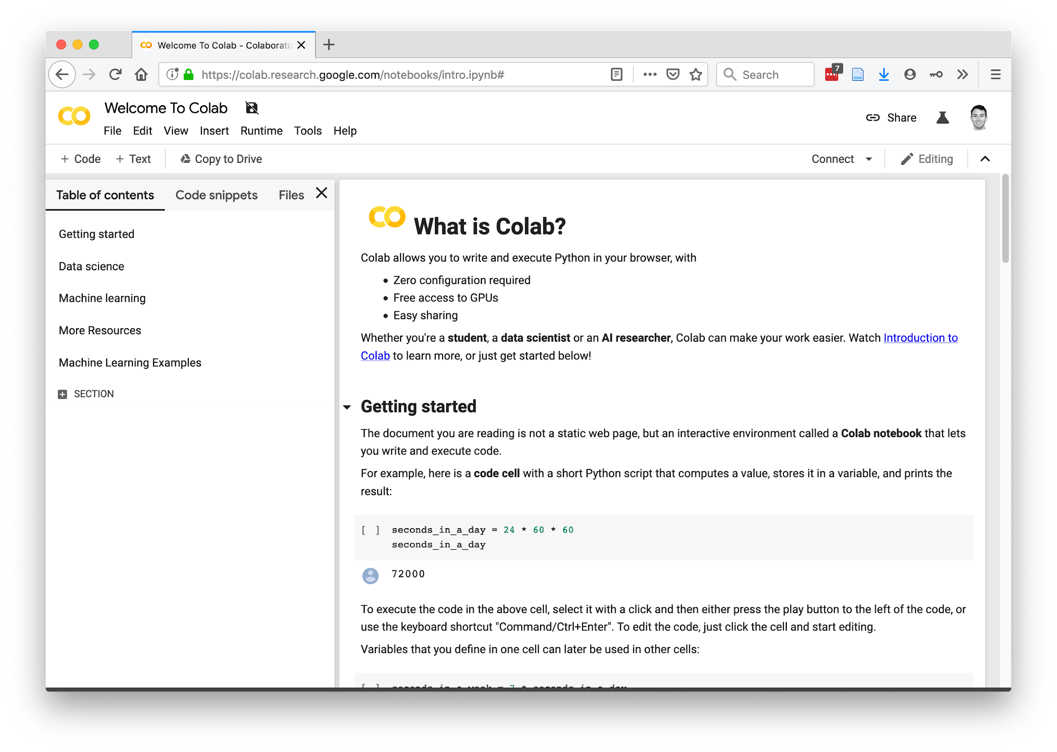
https://research.google.com/colaboratory/faq.html

Slide 7
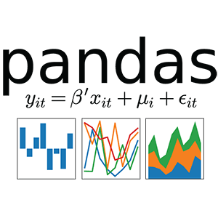

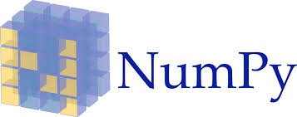





Why Python?
Tensorflow
Pytorch

Slide 8


vs.
Noun project

Slide 9


Slide 10
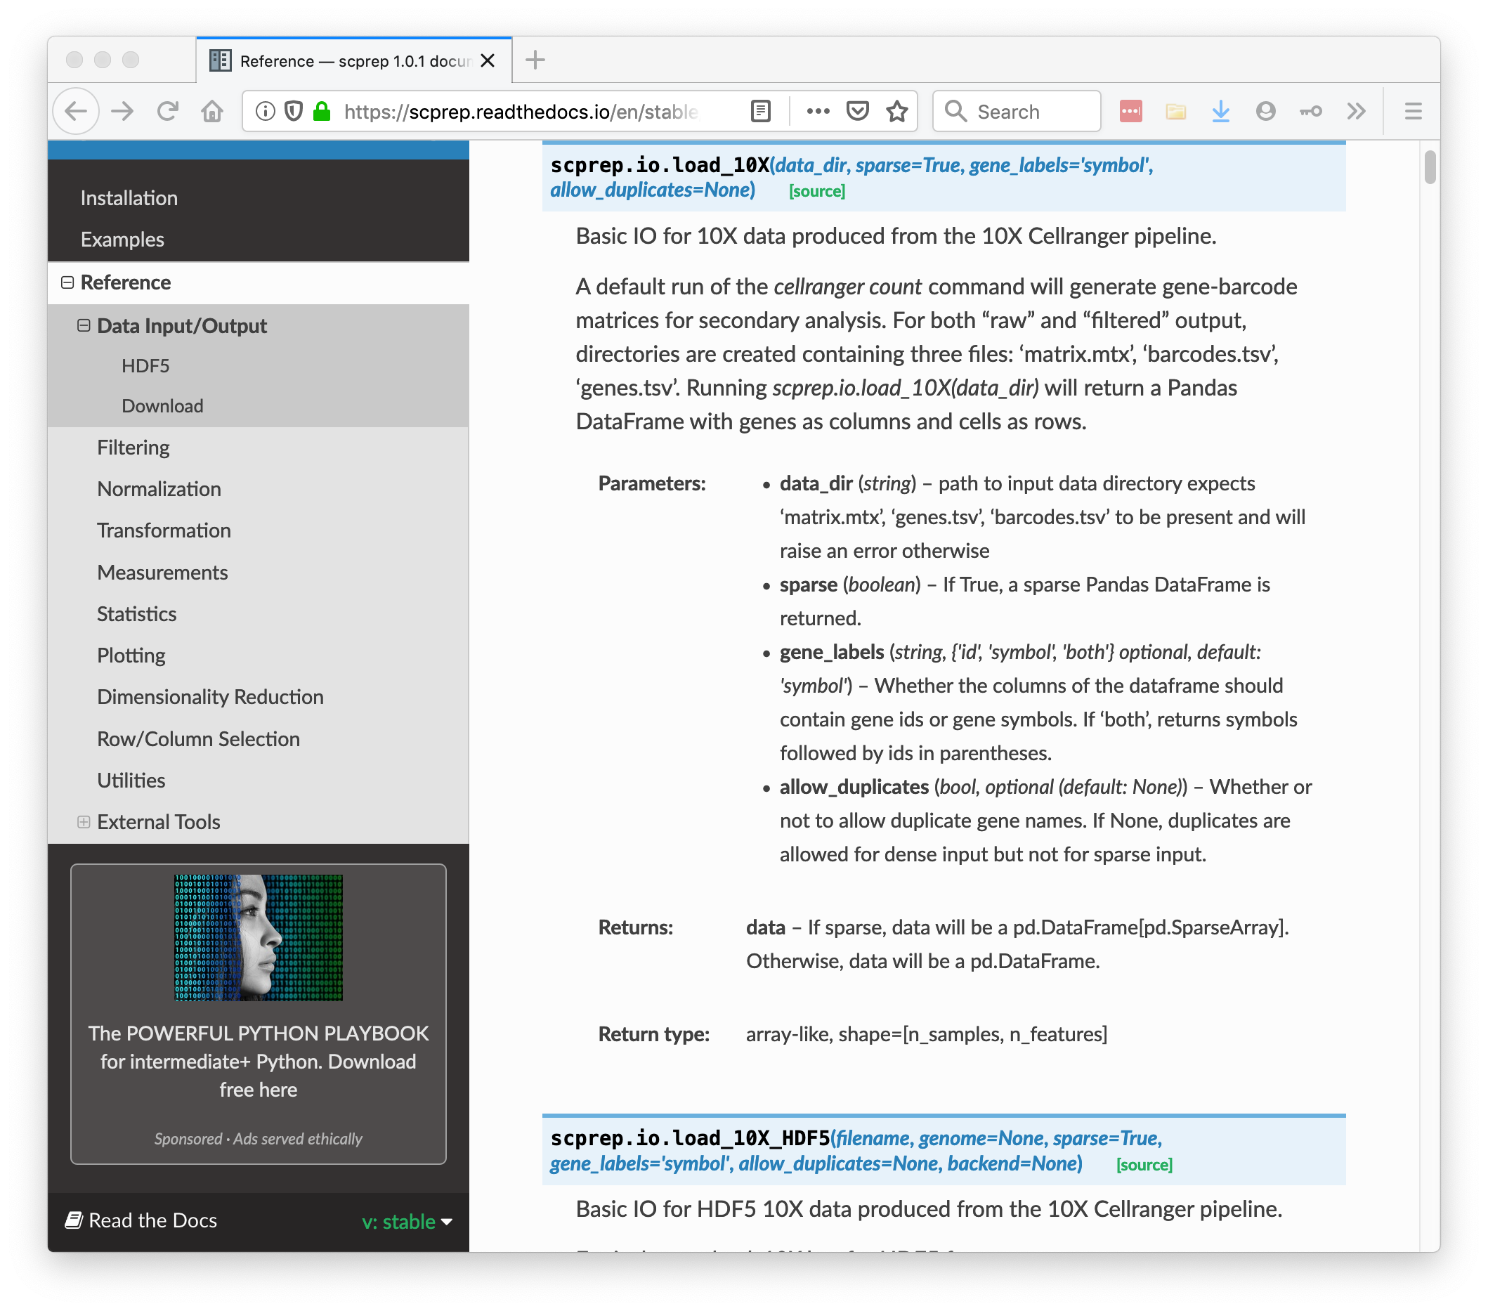

Slide 11
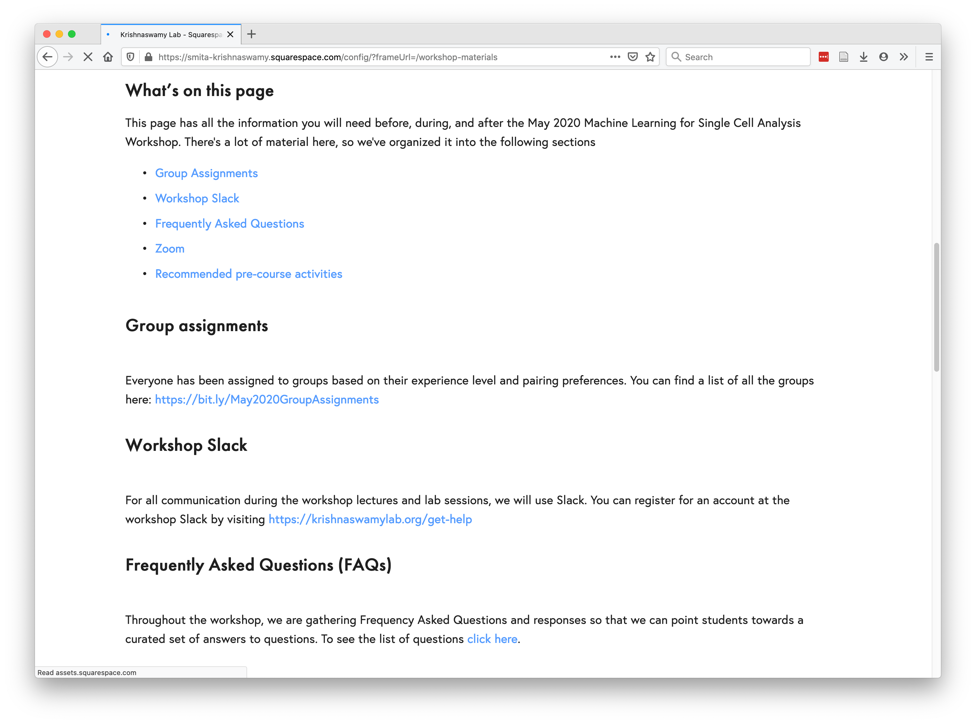
https://www.krishnaswamylab.org/workshop-materials

Slide 12
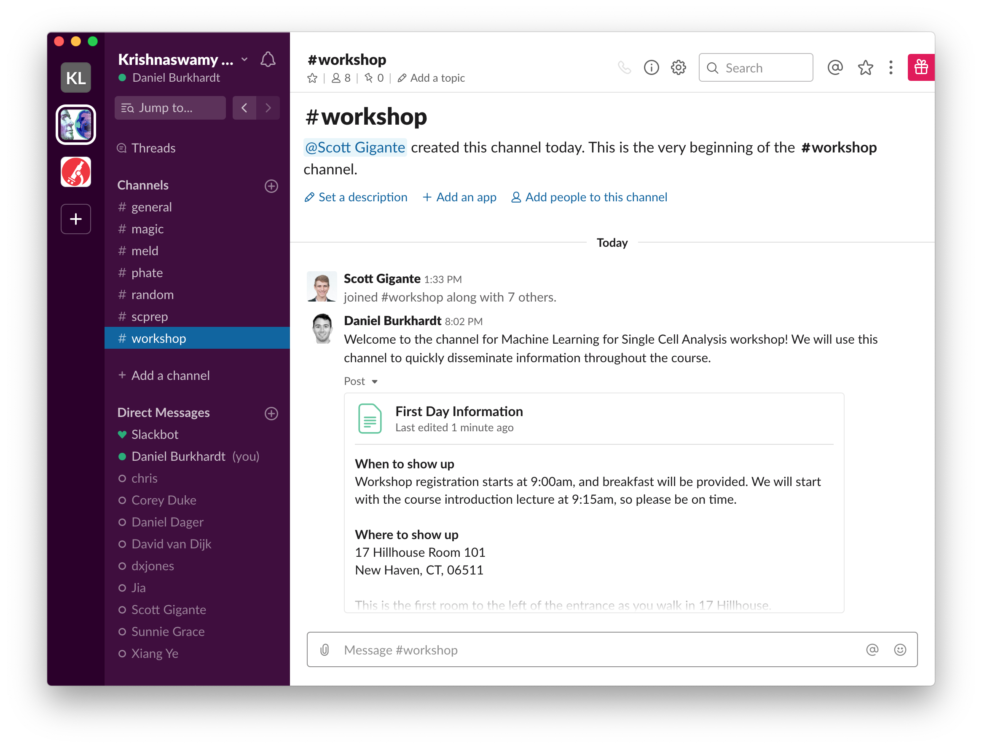
https://krishnaswamylab.org/get-help
Join: #2020-workshop-tas

